Slide 1
IEEE 802.11be Extremely High Throughput: The Next Generation of Wi-Fi Technology Beyond 802.11ax
Speaker: Sheng-Han Chung
(groundhogsh@gmail.com)
Advisor: Kai-Ten Feng, Ph.D, Professor
(ktfeng@mail.nctu.edu.tw)
Institute of Communications Engineering
National Chiao Tung University (NCTU) Hsinchu, Taiwan
July 15th, 2021

Slide 2
Outline
Introduction
Objectives and Timeline
Candidate Technical Features
320 MHz Bandwidth and More Efficient Utilization of Noncontiguous Spectrum
Multi-Band/Multi-Channel Aggregation and Operation
16 Spatial Streams and Multiple-Input Multiple-Output Protocol Enhancements
Multi-Access Point Coordination
Enhanced Link Adaptation and Retransmission Protocol
Coexistence in the 6 GHz Band
802.11be Performance Evaluation
Conclusions
References

Slide 3
Outline
Introduction
Objectives and Timeline
Candidate Technical Features
320 MHz Bandwidth and More Efficient Utilization of Noncontiguous Spectrum
Multi-Band/Multi-Channel Aggregation and Operation
16 Spatial Streams and Multiple-Input Multiple-Output Protocol Enhancements
Multi-Access Point Coordination
Enhanced Link Adaptation and Retransmission Protocol
Coexistence in the 6 GHz Band
802.11be Performance Evaluation
Conclusions
References

Slide 4
Introduction (1/5)
For past few years, abundant applications require extremely high throughput or low latency, e.g., AR/VR and high deﬁnition video [1], [2]
Frequency bands at sub-6 GHz becomes insufﬁcient due to increments of novel applications and mobile devices
mmWave provides high throughput thanks to its extremely large bandwidth
Although mmWave can provide huge spectrum resource, there are also some disadvantages to be solved
Severe attenuation by rain or oxygen absorption [3]
Suffer from much higher path loss than low frequency signal
These will limit the transmission range and power with mmWave system
Beamforming technique is adopted to overcome high path loss and attenuation due to the enhanced antenna gain [4]
With beamforming, mmWave signals will become directional and its transmission range will also increase due to higher transmission power [5]
Therefore, we have to find the optimal beam direction to maximize throughput

Slide 5
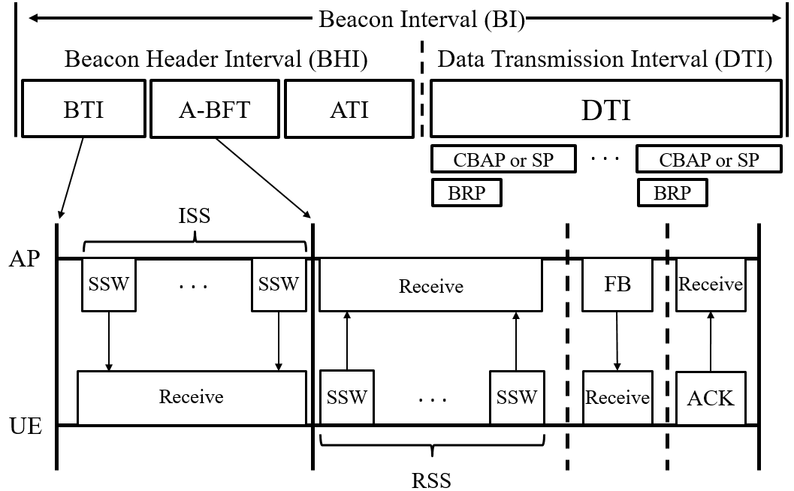
IEEE 802.11ad/ay Beam Training Frame Structure (2/4)
During BTI, the AP will train its optimal transmission beam, so called initiator sector sweep (ISS)
The AP will beacon sector sweep (SSW) frames from sequential sectors
In these SSW frames, the receiving user equipment (UE) will obtain the beam (index) ID and signal-to-noise ratio (SNR) of each beam

Slide 6
References (1/3)
[1] D. Lopez-Perez, A. Garcia-Rodriguez, L. Galati-Giordano, M. Kasslin and K. Doppler, "IEEE 802.11be Extremely High Throughput: The Next Generation of Wi-Fi Technology Beyond 802.11ax," in IEEE Communications Magazine, vol. 57, no. 9, pp. 113-119, September 2019, doi: 10.1109/MCOM.001.1900338.

